Slide 1
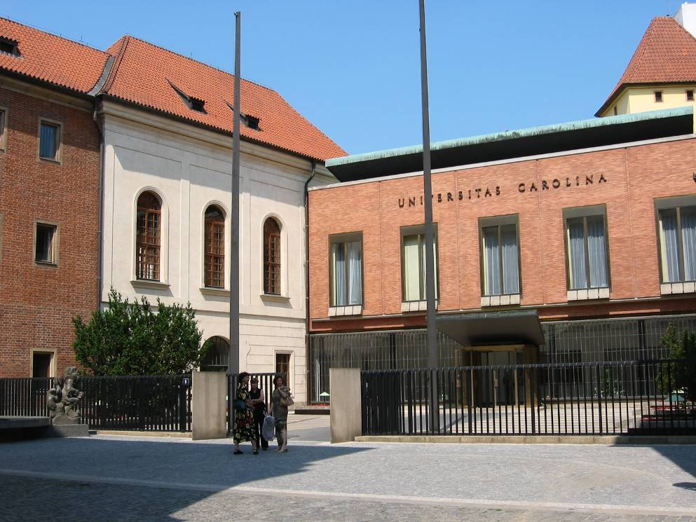
FSV UK Welcome Week for PhD Students Grant Opportunities for Young Researchers at Charles University Eva Horníčková, Research Office

Slide 2
Short overview
Individual opportunities
Institutional opportunities
Grant Agency of Charles University (GAUK)
Programme START
Specific University Research (Specifický vysokoškolský výzkum – SVV)
Programme Progres
University Research Centre (UNCE) + Primus projects

Slide 3
Grant Agency of Charles University
Duration 1, 2 or 3 years.
Team – principal investigator (PI) + supervisor + other students (M.A. or Ph.D.). Also as individual project possible (PI + supervisor).
PI has to be in the standard period of his/her study at the moment of the proposal submission. PI can submit only one project as a PI but could be a member of two others projects.
Max. budget 300 000 CZK a year (900 000 CZK for a project) – stipend for a student – 80 000 CZK a year, 160 000 CZK for a team a year.

Slide 4
Grant Agency of Charles University
Online application for a submission - https://is.cuni.cz/webapps/?lang=cs
The proposal can be prepared in Czech or in English.
Your supervisor has to agree with the proposal (it is condition for a submission) – electronically in the application.
Obligatory attachments – PI short CV; supervisor´s short CV and list of max. 10 publications from the last 5 years
For successful evaluation of the project - at least one published/accepted publication.

Slide 5
Grant Agency of Charles University
The next call - open 7 October 2020
Deadline for FSS students – 2 November 2020
Results – at the end of February
All information - https://cuni.cz/UK-2446.html and https://fsv.cuni.cz/veda-vyzkum/aktualni-vyzvy-veda-vyzkum (also the detailed manual for applicants)
Contact for GAUK at FSS: Eva Horníčková (eva.hornickova@fsv.cuni.cz, phone 222 112 267)

Slide 6
Programme START
Programme START is an unique call for the Ph.D. students of Charles University in this year.
Open now – deadline 30 October 2020, 12:00.
It is suited for the multimember teams (max 5 students).
The whole proposal is prepared in English.
Proposals cannot be submitted by a student who has exceeded the standard period of study.
The topic of the project must not be identical with the topic of the dissertation of any member of the team, but the outputs of the project can be used for dissertation work.

Slide 7
Programme START
Duration 1. 4. 2021 – 31. 3. 2023
Obligatory condition – PI and all members above 0.3 more must complete educational or research activities abroad for a minimum total period of 3 months. Internships abroad can be completed in both EU and non-EU countries.
Project design:
1) educational goals of all researchers - must be defined by each researcher - educational goal to be achieved by the researcher during the project.
2) research goal of the project - formulated topic, scientific hypothesis and questions for resolution, method of hypothesis verification

Slide 8
Programme START - Outputs
Research goal – for a project
Achieved results of professional research, professional articles or publications/monographs in the phase of submission to the review procedure
Active participation in a professional conference
Educational goals – for each member
Training to work with a new device or method usable in other professional activities - certificates of education or training etc.
Educational goal set on the basis of non-formal education during the grant solution - e.g. team communication, team leadership, communication skills, practical use of English, etc.

Slide 9
Programme START
Budget - The total amount of funds for the project is multiples of the unit cost of work capacity corresponding to a full-time equivalent of 0.1 per month. The value of this unit is 7,986 CZK, of which 4,700 CZK is intended for the researcher's personnel costs (e.g. PI obligatory 0.5 FTE = 23500 CZK a month).
Online application - https://login-veda.is.cuni.cz/idp/Authn/UserPassword
Information - https://cuni.cz/UKEN-1340.html and https://fsv.cuni.cz/veda-vyzkum/aktualni-vyzvy-veda-vyzkum
Contact for START at FSS: Eva Horníčková (eva.hornickova@fsv.cuni.cz, phone 222 112 267)

Slide 10
Institutional possibilities
Specific University Research
(Specifický vysokoškolský výzkum – SVV)
Specified mainly for Ph.D. students
Each institute has one project
Overview of the actual project including the coordinators - https://fsv.cuni.cz/veda-vyzkum/vyzkumne-vedecke-projekty/specificky-vysokoskolsky-vyzkum
Stipend for research, publications, travel (individual according to the institute rules)

Slide 11
Institutional possibilities
Programme Progres
Overview of running program at FSS - https://fsv.cuni.cz/veda-vyzkum/vnitrouniverzitni-programy/progres
Decisions about the team and about budget – directors of the institute.
University Research Centre (UNCE) + Primus projects
individual projects with the PI
Overview of the projects - https://fsv.cuni.cz/veda-vyzkum/vnitrouniverzitni-programy
Ph.D. students are expected team members.

Slide 12
External opportunities
Foundations
Sophia Foundation (focused on Economics) - http://www.nadacesophia.cz/prisp.asp
Josef Hlávka Foundation - http://www.hlavkovanadace.cz/
Jan Hus Educational Foundation - https://www.vnjh.cz/
Czech Literary Fond Foundation – travel stipends - https://nclf.cz/nadacni-program/

Slide 13
Research Office at Faculty
Information about the open calls - https://fsv.cuni.cz/veda-vyzkum/aktualni-vyzvy-veda-vyzkum
Information about the regular announced grant competition – https://fsv.cuni.cz/veda-vyzkum/aktualni-vyzvy-veda-vyzkum/grantovy-rok
The manuals for the main competitions also in English.

Slide 14
Research Office at Faculty
Research office helps with the technical parts of the proposal, with the budget, with the institutional attachments, arranges the necessary signatures of dean/rector and usually submits the proposal to the grant agency.
All submissions of the research proposals – please through the Research office.
If the proposal gets the financial support, we help with the start of the project, with reports, with changes and with questions connected with the grant rules.

Slide 15
Research Office at Faculty
Smetanovo nábř. 6, Hollar building, 1 floor, room 114
Overview of the staff - https://fsv.cuni.cz/fakulta/dekanat/oddeleni-vedy – 4 persons for the different grant competitions
If you do not know please contact Eva Horníčková, eva.hornickova@fsv.cuni.cz, phone 222 112 267.

Slide 16
Charles University Courses

Slide 17
Thank you for your attention!

