Slide 1
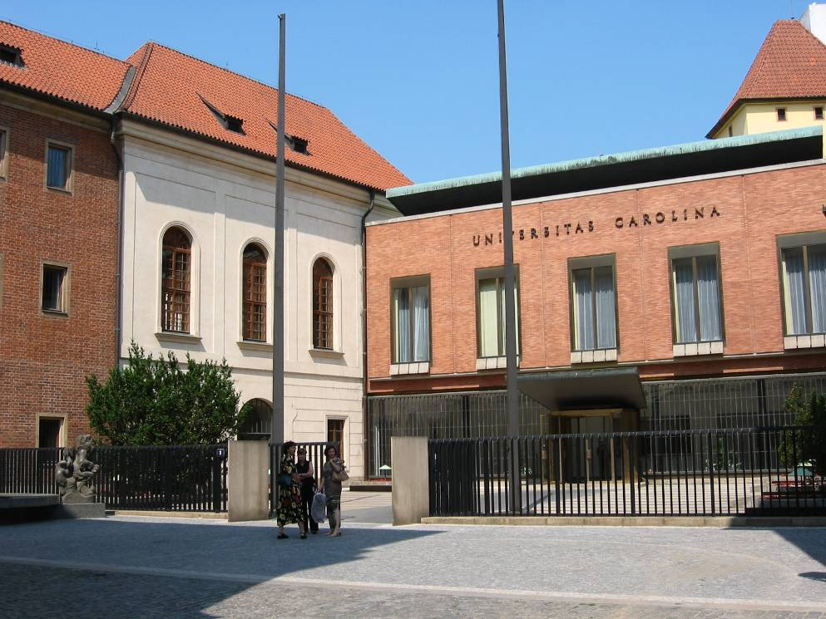
Grant Opportunities for Young Researchers at Charles University Eva Horníčková, Research Office

Slide 2
Short overview
Individual opportunities
Institutional opportunities
Grant Agency of Charles University (GAUK)
Projects 4EU+
Mobility projects
Specific University Research (Specifický vysokoškolský výzkum – SVV)
Programme Cooperatio
University Research Centre (UNCE) + Primus projects

Slide 3
Grant Agency of Charles University
Duration 1, 2 or 3 years.
Team – principal investigator (PI) + supervisor + other students (M.A. or PhD.). Also, as individual project possible (PI + supervisor).
PI must be in the standard period of his/her study at the moment of the proposal submission. PI can submit only one project as a PI but could be a member of two other projects.
Max. budget 300 000 CZK a year (900 000 CZK for a project) – stipend for a student – 80 000 CZK a year, 160 000 CZK for a team a year.

Slide 4
Grant Agency of Charles University
The next call - open October 2024
All information - https://cuni.cz/UK-2446.html and https://cuni.cz/UKEN-753.html
https://fsv.cuni.cz/veda-vyzkum/aktualni-vyzvy-veda-vyzkum (also the detailed manual for applicants)
Contact for GAUK at FSS: Eva Horníčková (eva.hornickova@fsv.cuni.cz, phone 222 112 267)

Slide 5
4EU+ student mini-grants
Open call - deadline FSS 26.2. 2024
The projects can focus on initiating international research collaboration, organizing joint educational activities (workshops, soft skill courses, etc.), developing socio-cultural collaboration etc.
Project has to involve at least three 4EU+ member universities (Charles University + Heidelberg Universität, Sorbonne Université, Københavns Universitet, Université de Genève, Università degli Studi di Milano, Uniwersytet Warszawski, Université Pantheon-Assas).
The maximum amount to apply for is CZK 150,000 (approx. EUR 6100).
All information - https://fsv.cuni.cz/veda-vyzkum/aktualni-vyzvy-veda-vyzkum and https://cuni.cz/UK-12268.html
Contact at FSS: Tereza Broučková (tereza.brouckova@fsv.cuni.cz, phone 222 112 232)

Slide 6
Institutional possibilities
Specific University Research
(Specifický vysokoškolský výzkum – SVV)
Specified mainly for Ph.D. students
Each institute has one project
Overview of the actual project including the coordinators - https://fsv.cuni.cz/veda-vyzkum/vyzkumne-vedecke-projekty/specificky-vysokoskolsky-vyzkum
Stipend for research, publications, travel (individual according to the institute rules)

Slide 7
Institutional possibilities
Programme Cooperatio
Overview of running programmes at FSS – https://fsv.cuni.cz/veda-vyzkum/vnitrouniverzitni-programy/cooperatio
Decisions about the team and about budget – directors of the institute.
University Research Centre (UNCE) + Primus projects
Individual projects with the PI
Overview of the projects - https://fsv.cuni.cz/veda-vyzkum/vnitrouniverzitni-programy
PhD. students are expected as team members.

Slide 8
External opportunities
Foundations
Sophia Foundation (focused on Economics) - http://www.nadacesophia.cz/prisp.asp
Josef Hlávka Foundation - http://www.hlavkovanadace.cz/
Jan Hus Educational Foundation - https://www.vnjh.cz/
Czech Literary Fond Foundation – travel stipends - https://nclf.cz/nadacni-program/

Slide 9
Research Office at Faculty
Information about the open calls - https://fsv.cuni.cz/veda-vyzkum/aktualni-vyzvy-veda-vyzkum
Information about the regular announced grant competition – https://fsv.cuni.cz/veda-vyzkum/aktualni-vyzvy-veda-vyzkum/grantovy-rok
The manuals for the main competitions also in English.

Slide 10
Research Office at Faculty
Research office helps with the questions about the grant rules, with the technical parts of the proposal, with the institutional attachments, arranges the necessary signatures of dean/rector and usually submits the proposal to the grant agency.
Each institute has own project administrator who helps you with the project budget (contact through the secretary office).
All submissions of the research proposals (if faculty is the project holder) must have the approval of the institute and the Research office. It is necessary to meet the faculty deadline for the submission.
If the proposal gets the financial support, we help with the start of the project, with reports, with changes and with questions connected with the grant rules.

Slide 11
Research Office at Faculty
Smetanovo nábř. 6, Hollar building, 1 floor, room 114 (Applied research – Voršilská, room 506)
Overview of the staff - https://fsv.cuni.cz/fakulta/dekanat/oddeleni-vedy – 6 persons for the different grant competitions
If you do not know please contact Eva Horníčková, eva.hornickova@fsv.cuni.cz, phone 222 112 267.

Slide 12
The Research Ethics Committee
Purpose – to support researchers at the Faculty of Social Sciences by consulting and approving the ethical aspects of their research projects (incl. the research in the dissertation work)
Each institute has one member in the committee
Consultation through the online form
https://fsv.cuni.cz/fakulta/organy-fakulty/komise-pro-etiku-ve-vyzkumu
https://fsv.cuni.cz/en/research/research-ethics-committee

Slide 13
Personal Identifiers
All Ph.D. students must have the personal identifiers - Rector’s Measure no. 24/2023
Types of identifiers
ORCID ID
ResearcherID - Publons of the Web of Science database
Scopus Author ID of the Scopus database
All information are available at https://knihovna.fsv.cuni.cz/en/research-support/personal-identifiers
Contact at the faculty: Mgr. Michala Sošková
(e-mail: michala.soskova@fsv.cuni.cz)

Slide 14
Thank you for your attention!

